Slide 1
International Economic Relations ECON 308
Labor Productivity and Comparative Advantage: The Ricardian Model
(Chapter 3 Part 2)
Instructor: Muhebullah Karimzada
Notes:
If this PowerPoint presentation contains mathematical equations, you may need to check that your computer has the following installed:
1) MathType Plugin
2) Math Player (free versions available)
3) NVDA Reader (free versions available)

Slide 2
Trade in the Ricardian Model (1 of 4)
to indicate foreign country variables.
When one country can produce a unit of a good with less labor than another country, we say that the first country has an absolute advantage in producing that good.
If
Home labor is more efficient than Foreign in
producing cheese.
Does that guarantee that Home should export cheese?

Slide 3
Trade in the Ricardian Model (2 of 4)
Comparative advantage, not absolute advantage, determines the pattern of trade (more about this distinction later).
Suppose that the home country has a comparative advantage in cheese production: its opportunity cost of producing cheese is lower than the foreign country.
When the home country increases cheese production, it reduces wine production less than the foreign country would.
Notes:
Start fraction a sub start expression L C end expression over a sub start expression L W end expression end fraction is less than start fraction a to the asterisk power sub start expression L C end expression over a to the asterisk power sub start expression L W end expression end fraction

Slide 4
Trade in the Ricardian Model (3 of 4)
Since the slope of the P P F indicates the opportunity cost of cheese in terms of wine, Foreign’s P P F is steeper than Home’s.
To produce one pound of cheese, must stop producing more gallons of wine in Foreign than in Home.

Slide 5
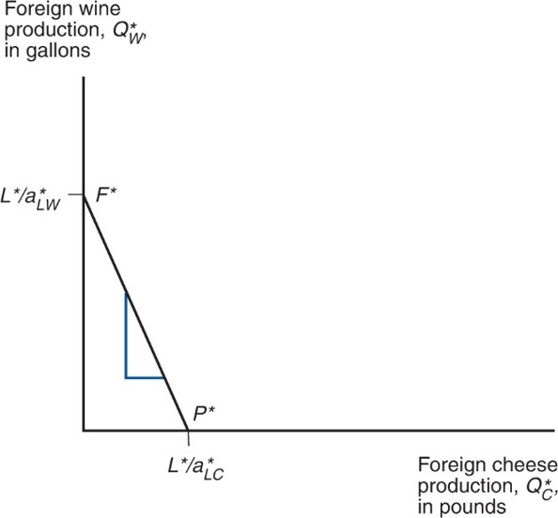
Figure 3.2 Foreign’s Production Possibility Frontier
Because Foreign’s relative unit labor requirement in cheese is higher than Home’s (it needs to give up many more units of wine to produce one more unit of cheese), its production possibility frontier is steeper.
Notes:
The line F asterisk P asterisk falls steeply from the ratio L asterisk over, ay asterisk, sub L W on the y-axis to point L asterisk over, ay asterisk, sub L C on the x-axis.

Slide 6
Trade in the Ricardian Model (4 of 4)
Before any trade occurs, the relative price of cheese to wine reflects the opportunity cost of cheese in terms of wine in each country.
In the absence of any trade, the relative price of cheese to wine will be higher in Foreign than in Home if Foreign has the higher opportunity cost of cheese.
It will be profitable to ship cheese from Home to Foreign (and wine from Foreign to Home)—where does the relative price of cheese to wine settle?

Slide 7
Determining the Relative Price after Trade (1 of 8)
To see how all countries can benefit from trade, need to find relative prices when trade exists.
First calculate the world relative supply of cheese: the quantity of cheese supplied by all countries relative to the quantity of wine supplied by all countries:

Slide 8
Determining the Relative Price after Trade (2 of 8)
If the relative price of cheese falls below the opportunity cost of cheese in both countries
No cheese would be produced.
Domestic and foreign workers would be willing to produce only wine (where wage is higher).
Notes:
Start fraction P sub C over P sub W end fraction is less than a sub start expression L C end expression over a sub start expression L W end expression end fraction is less than start fraction a to the asterisk power sub start expression L C end expression over a to the asterisk power sub start expression L W end expression end fraction,

Slide 9
Determining the Relative Price after Trade (3 of 8)
When the relative price of cheese equals the opportunity cost in the home country
Domestic workers are indifferent about producing wine or cheese (wage when producing wine same as wage when producing cheese).
Foreign workers produce only wine.
Notes:
Start fraction P sub C over P sub W end fraction = a sub start expression L C end expression over a sub start expression L W end expression end fraction is less than start fraction a to the asterisk power sub start expression L C end expression over a to the asterisk power sub start expression L W end expression end fraction,

Slide 10
Determining the Relative Price after Trade (4 of 8)
When the relative price of cheese settles strictly in between the opportunity costs of cheese
Domestic workers produce only cheese (where their wages are higher).
Foreign workers still produce only wine (where their wages are higher).
World relative supply of cheese equals Home’s maximum cheese production divided by Foreign’s maximum wine production
Notes:
Start fraction a sub start expression L C end expression over a sub start expression L W end expression end fraction is less than Start fraction P sub C over P sub W end fraction is less than start fraction a to the asterisk power sub start expression L C end expression over a to the asterisk power sub start expression L W end expression end fraction,

Slide 11
Determining the Relative Price after Trade (5 of 8)
When the relative price of cheese equals the opportunity cost in the foreign country
Foreign workers are indifferent about producing wine or cheese (wage when producing wine same as wage when producing cheese).
Domestic workers produce only cheese.
Notes:
Start fraction a sub start expression L C end expression over a sub start expression L W end expression end fraction is less than Start fraction P sub C over P sub W end fraction = start fraction a to the asterisk power sub start expression L C end expression over a to the asterisk power sub start expression L W end expression end fraction,

Slide 12
Determining the Relative Price after Trade (6 of 8)
If the relative price of cheese rises above the opportunity cost of cheese in both countries
No wine is produced.
Domestic and foreign workers are willing to produce only cheese (where wage is higher).
Notes:
Start fraction a sub start expression L C end expression over a sub start expression L W end expression end fraction is less than start fraction a to the asterisk power sub start expression L C end expression over a to the asterisk power sub start expression L W end expression end fraction is less than Start fraction P sub C over P sub W end fraction,

Slide 13
Determining the Relative Price after Trade (7 of 8)
World relative supply is a step function:
First step at relative price of cheese equal to Home’s
opportunity cost
in the example.
Jumps when world relative supply of cheese equals Home’s maximum cheese production divided by Foreign’s
maximum wine production
which equals 1 in the
example.
Second step at relative price of cheese equal to Foreign’s
opportunity cost
which equals 2 in the example.

Slide 14
Determining the Relative Price after Trade (8 of 8)
Relative demand of cheese is the quantity of cheese demanded in all countries relative to the quantity of wine demanded in all countries.
As the price of cheese relative to the price of wine rises, consumers in all countries will tend to purchase less cheese and more wine so that the relative quantity demanded of cheese falls.

Slide 15
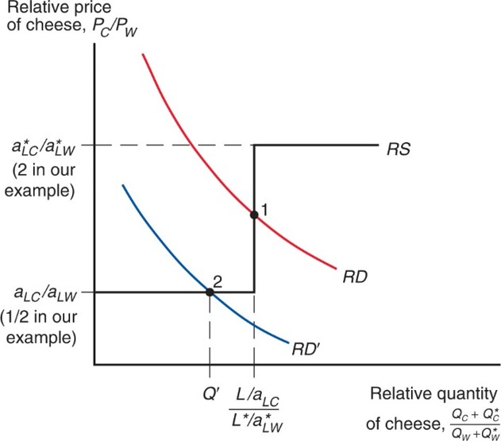
Figure 3.3 World Relative Supply and Demand
The R D and R D′ curves show that the demand for cheese relative to wine is a decreasing function of the price of cheese relative to that of wine, while the R S curve shows that the supply of cheese relative to wine is an increasing function of the same relative price.
Notes:
The R S curve extends horizontally from the ratio ay sub L C over, ay sub L W on the y-axis, which is one-half in the example. It then rises vertically from the x-value, ratio L over ay, sub L C over, L asterisk over, ay asterisk, sub L W to the y-value, ay asterisk, sub L C over ay asterisk, sub L W. The R S curve then continues horizontally to the right at ay asterisk sub L C over ay asterisk sub L W, which is 2 in the example. The plots for R D and R D prime are parallel and fall with decreasing steepness; R D is higher than R D prime. R D crosses the R S graph at point 1, the ratio L over ay, sub L C over, L asterisk over, ay asterisk, sub L W on the x-axis; point 1 is roughly midway between ay asterisk sub L C, over ay asterisk, sub L W, and ay sub L C over ay sub L W. R D prime crosses the R S graph at point 2, where x = Q prime, to the left of point 1, and where y = ay sub L C over ay sub L W on the y-axis.

Slide 16
The Gains from Trade (1 of 4)
Gains from trade come from specializing in the type of production that uses resources most efficiently, and using the income generated from that production to buy the goods and services that countries desire.
“Using resources most efficiently” means producing a good in which a country has a comparative advantage.

Slide 17
The Gains from Trade (2 of 4)
Domestic workers earn a higher income from cheese production because the relative price of cheese increases with trade.
Foreign workers earn a higher income from wine production because the relative price of cheese decreases with trade (making cheese cheaper), and the relative price of wine increases with trade.

Slide 18
The Gains from Trade (3 of 4)
Think of trade as an indirect method of production that converts cheese into wine or vice versa.
Without trade, a country has to allocate resources to produce all of the goods that it wants to consume.
With trade, a country can specialize its production and exchange for the mix of goods that it wants to consume.

Slide 19
The Gains from Trade (4 of 4)
Consumption possibilities expand beyond the production possibility frontier when trade is allowed.
With trade, consumption in each country is expanded because world production is expanded when each country specializes in producing the good in which it has a comparative advantage.

Slide 20
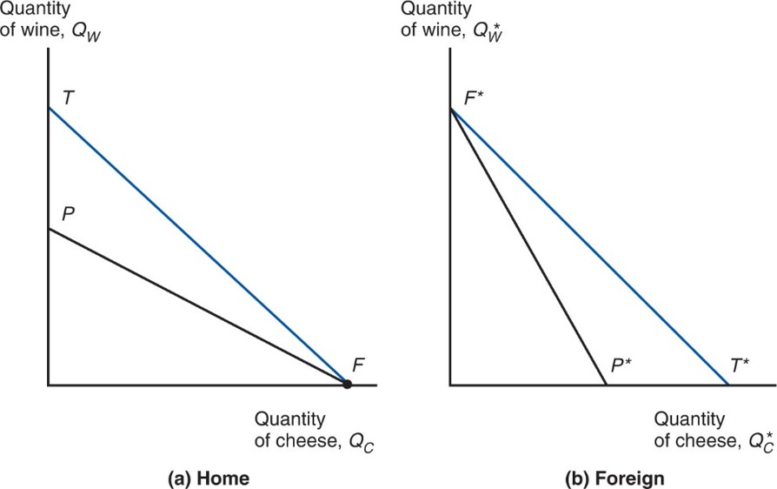
Figure 3.4 Trade Expands Consumption Possibilities
International trade allows Home and Foreign to consume anywhere within the outer lines, which lie outside the countries’ production frontiers.
Notes:
A falling line P F, beginning at P on the y-axis, ends at point F on the x-axis. A second line, T F, begins above point P on the y-axis at point T, and falls more steeply than P F to point F on the x-axis. The second graph, b, foreign, plots the quantity of wine, Q asterisk, sub W on the y-axis versus quantity of cheese, Q asterisk, sub C on the x-axis. Two falling lines begin at point F asterisk on the y-axis. Line F asterisk P asterisk falls more steeply than line F asterisk T asterisk, with T asterisk to the right of P asterisk on the x-axis.

Slide 21
A Numerical Example (1 of 5)
Unit labor requirements | Cheese | Wine
Home | a sub start expression L C end expression = 1 hour per pound | a sub start expression L W end expression = 2 hours per gallon
Foreign | a to the asterisk power sub start expression L C end expression = 6 hours per pound | a to the asterisk power sub start expression L W end expression = 3 hours per gallon
What is the home country’s opportunity cost of producing
cheese?
to produce one pound of
cheese, stop producing

Slide 22
A Numerical Example (2 of 5)
The home country is more efficient in both industries, but has a comparative advantage only in cheese production.
The foreign country is less efficient in both industries, but has a comparative advantage in wine production.
Notes:
1 half = Start fraction a sub start expression L C end expression over a sub start expression L W end expression end fraction is less than start fraction a to the asterisk power sub start expression L C end expression over a to the asterisk power sub start expression L W end expression end fraction = 2

Slide 23
A Numerical Example (3 of 5)
With trade, the equilibrium relative price of cheese to wine settles between the two opportunity costs of cheese.
Suppose the intersection of R S and R D occurs at
so one pound of cheese trades for one gallon of
wine.
Trade causes the relative price of cheese to rise in the home country and fall in foreign.

Slide 24
A Numerical Example (4 of 5)
With trade, the foreign country can buy one pound of cheese for
instead of stopping production of
of wine to free up enough labor to produce one pound of cheese in the absence of trade.
Suppose
The foreign country can trade its 1,000
gallons maximum production of wine for 1,000 pounds of cheese, instead of the 500 pounds of cheese it could produce itself.

Slide 25
A Numerical Example (5 of 5)
With trade, the home country can buy one gallon of wine for
instead of stopping production of
of cheese to free up enough labor to produce one gallon of wine in the absence of trade.
The home country can trade its 1,000 pounds maximum production of cheese for 1,000 gallons of wine, instead of the 500 gallons of wine it could produce itself.

Slide 26
Relative Wages (1 of 5)
Relative wages are the wages of the home country relative to the wages in the foreign country.
Productivity (technological) differences determine relative wage differences across countries.
The home wage relative to the foreign wage will settle in between the ratio of how much better Home is at making cheese, and how much better it is at making wine compared to Foreign.
Relative wages cause Home to have a cost advantage in only cheese, and Foreign to have a cost advantage in only wine.

Slide 27
Relative Wages (2 of 5)
Suppose that
Since domestic workers specialize in cheese production after trade, their hourly wages will be
Since foreign workers specialize in wine production after trade, their hourly wages will be
The relative wage of domestic workers is therefore

Slide 28
Relative Wages (3 of 5)
The relative wage lies between the ratio of the productivities in each industry.
The home country is
times as productive in
cheese production, but only
times as
productive in wine production.
The home country has a wage three times higher than the foreign country.

Slide 29
Relative Wages (4 of 5)
These relationships imply that both countries have a cost advantage in production.
High wages can be offset by high productivity.
Low productivity can be offset by low wages.
In the home economy, producing one pound of cheese costs
but would have cost
in Foreign.
In the foreign economy, producing one gallon of wine costs
but would have cost $24
in Home.

Slide 30
Relative Wages (5 of 5)
Because foreign workers have a wage that is only
the wage of domestic workers, they are able to attain a cost advantage in wine production, despite low productivity.
Because domestic workers have a productivity that is six times that of foreign workers in cheese production, they are able to attain a cost advantage in cheese production, despite high wages.

Slide 31
Do Wages Reflect Productivity? (1 of 2)
Do relative wages reflect relative productivities of the two countries?
Evidence shows that low wages are associated with low productivity.
Wage of most countries relative to the United States is similar to their productivity relative to the United States.

Slide 32
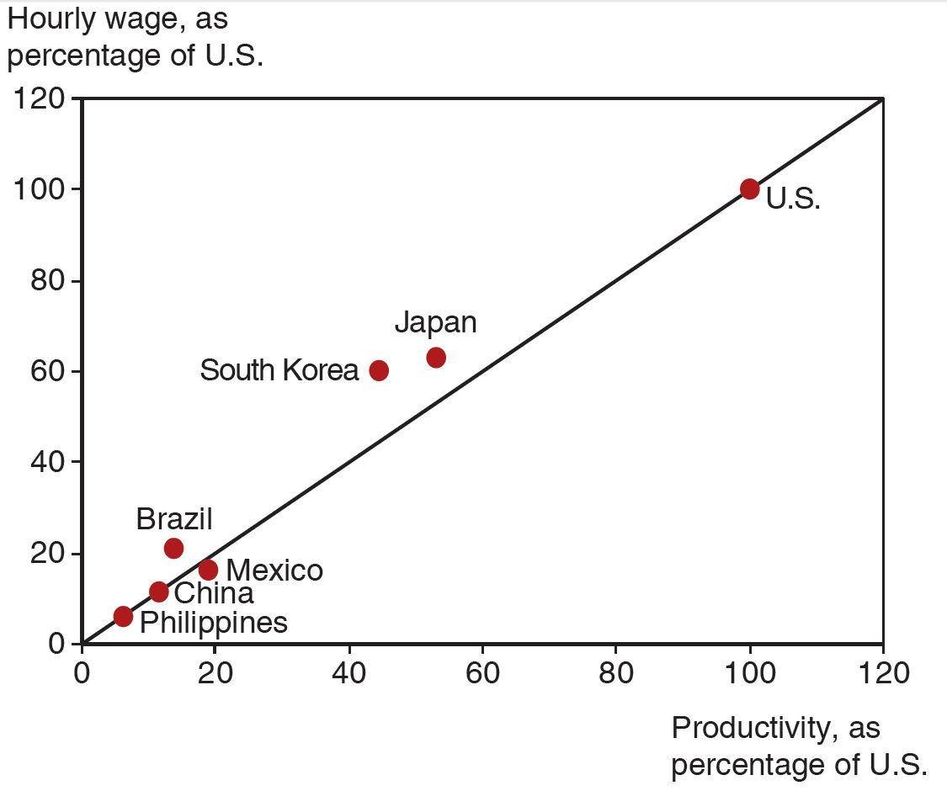
Productivity and Wages
A country’s wage rate is roughly proportional to the country’s productivity
Source: International Monetary Fund and The Conference Board.
Notes:
A line of best fit rises from (0, 0) through (120, 120). The Philippines, China, Mexico, and Brazil are clustered below point (20, 20). Korea and Japan are near the mid-point of the line, at approximately (50, 60). The U S is plotted on the line at (100, 100). All values estimated.

Slide 33
Do Wages Reflect Productivity? (2 of 2)
Other evidence shows that wages rise as productivity rises.
As recently as 1975, wages in South Korea were only 5 percent of those of the United States.
As South Korea’s labor productivity rose (to about half of the U.S. level by 2007), so did its wages.

Slide 34
Empirical Evidence (1 of 3)
Do countries export those goods in which their productivity is relatively high?
The ratio of U.S. to British exports in 1951 compared to the ratio of U.S. to British labor productivity in 26 manufacturing industries suggests yes.
At this time, the United States had an absolute advantage in all 26 industries, yet the ratio of exports was low in the least productive sectors of the United States.

Slide 35
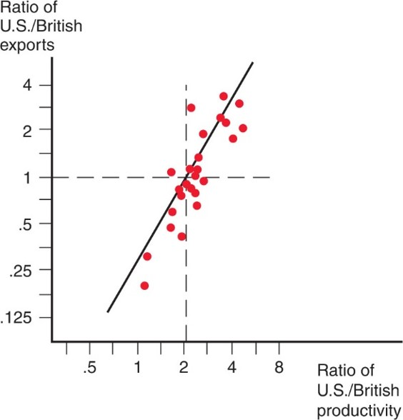
Figure 3.6 Productivity and Exports
A comparative study showed that U.S. exports were high relative to British exports in industries in which the United States had high relative labor productivity. Each dot represents a different industry.
Notes:
The data forms a pattern closely following a steeply rising line that extends from (0.7, 0.130) through (1, 2) and (6, 5). Most data points are clustered at the intersection of a dashed horizontal line, y = 1, and dashed vertical line, x = 2, and the rising line at point (2, 1).

Slide 36
Empirical Evidence (2 of 3)
A very poor country like Bangladesh can have comparative advantage in clothing despite being less productive in clothing than other countries such as China because it is even less productive compared to China in other sectors.
Productivity (output per worker) in Bangladesh is only 28 percent of China’s on average.
In apparel, productivity in Bangladesh was about 77 percent of China’s, creating strong comparative advantage in apparel for Bangladesh.

Slide 37
Table 3.3 Bangladesh Versus China, 2011
Blank | Bangladeshi Output per Worker as % of China | Bangladeshi exports as % of China
All industries | 28.5 | 1.0
Apparel | 77 | 15.5
Source: McKinsey and Company, “Bangladesh’s ready-made garments industry: The challenge of growth,” 2012; U N Monthly Bulletin of Statistics.

Slide 38
Empirical Evidence (3 of 3)
The main implications of the Ricardian model are well supported by empirical evidence:
productivity differences play an important role in international trade
comparative advantage (not absolute advantage) matters for trade

